Slide 1



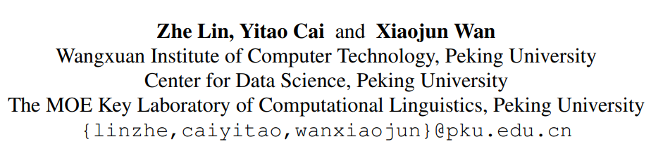





Chongqing University of Technology
ATAI
Advanced Technique of Artificial Intelligence
Chongqing Unive
Towards Document-Level Paraphrase Generation
with Sentence Rewriting and Reordering
Code： https://github.com/L-Zhe/CoRPG.
（EMNLP-2021)
Reported by Zicong Dou

Slide 2

Chongqing University of Technology
ATAI
Advanced Technique of Artificial Intelligence
Chongqing University of Technology
1. Introduction
2. Approach
3. Experiments

Slide 3
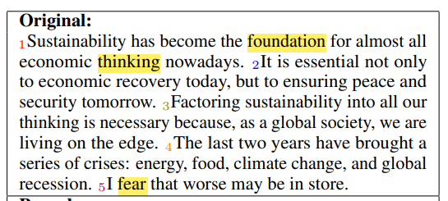
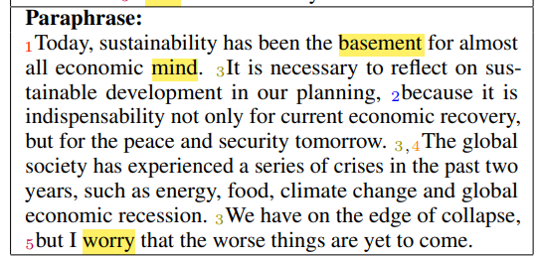
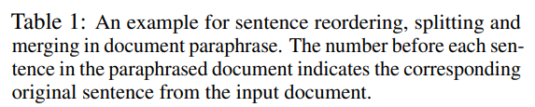
Introduction
3:将可持续发展纳入我们所有人的思维是必要的，因为作为一个全球化社会，我们正生活在边缘。
4:过去两年带来了一系列危机:能源、粮食、气候变化和全球经济衰退。
在我们的规划中有必要考虑可持续发展，因为它不仅对当前的经济复苏是不可或缺的，而且对未来的和平与安全也是不可或缺的。 在过去的两年里，全球社会经历了一系列的危机，如能源、粮食、气候变化和全球经济衰退。 我们已经处于崩溃的边缘，

Slide 4
Introduction
• We are the first to explore the problem of document-level paraphrase generation.
• We propose a new model CoRPG (Coherence Relationship guided recase Generation) to address both sentence rewriting and reordering for document-level paraphrase generation.
Our model can leverage graph GRU to learn coherence-aware representations of sentences and re-arrange the input sentences.

Slide 5
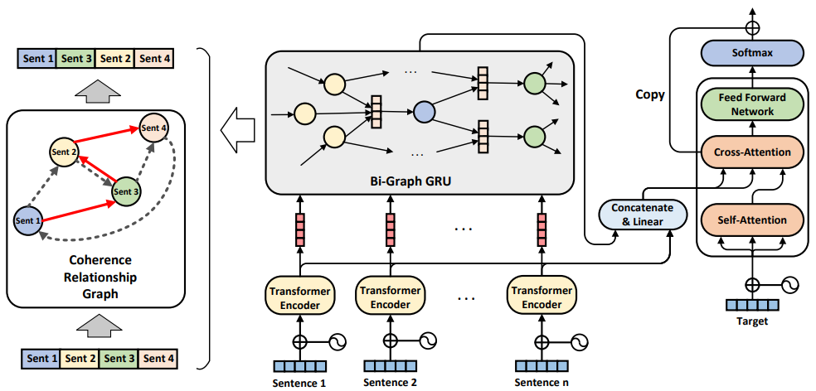
Approach

Slide 6










Slide 7
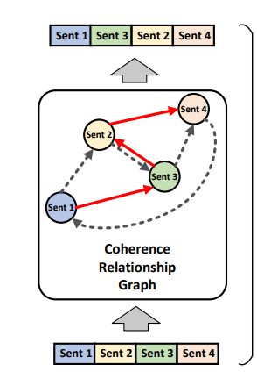

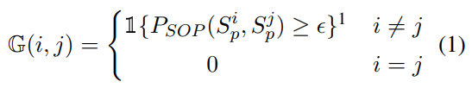

Approach

Slide 8








Slide 9
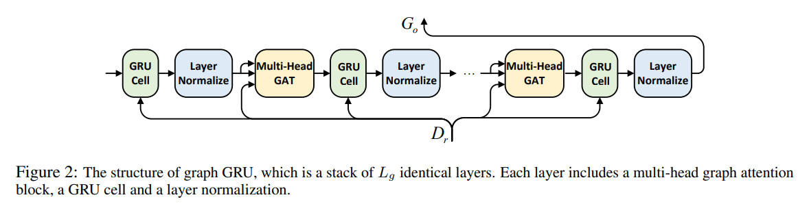

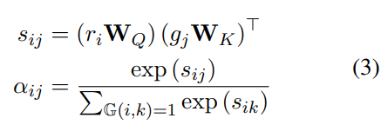



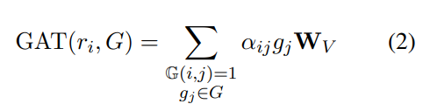




Approach

Slide 10
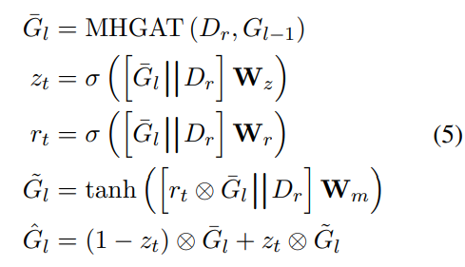
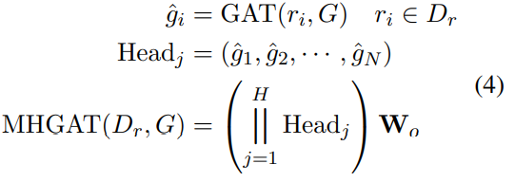

Approach

Slide 11


Approach

Slide 12

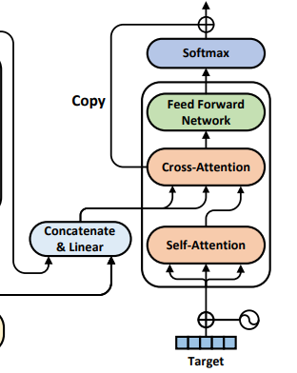
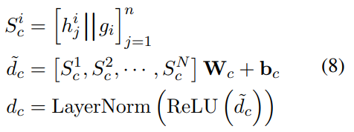



Approach

Slide 13
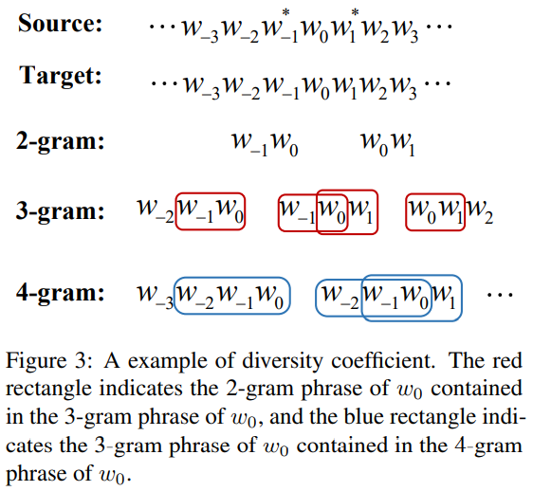

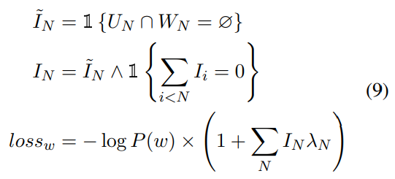



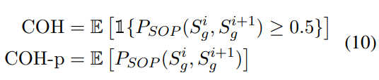
Approach

Slide 14
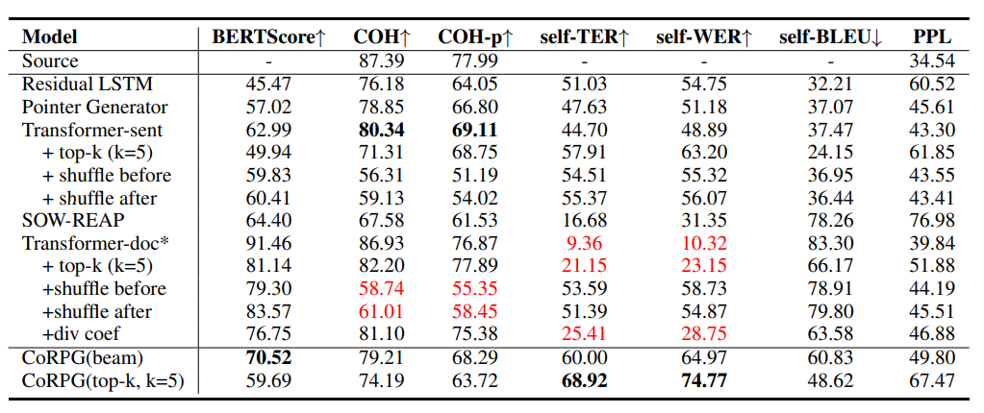
Experiments

Slide 15
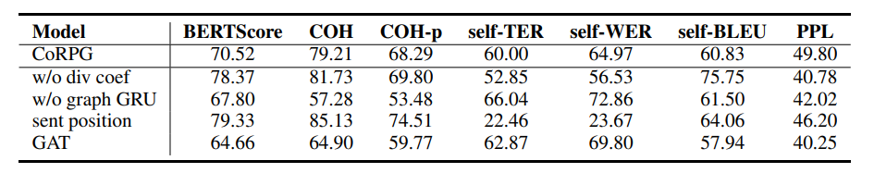
Experiments

Slide 16
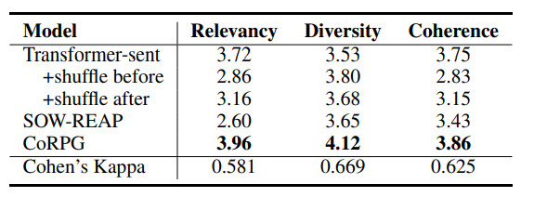
Experiments

Slide 17
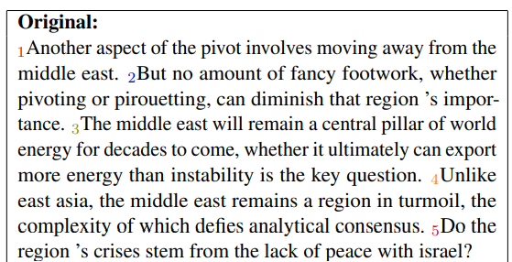
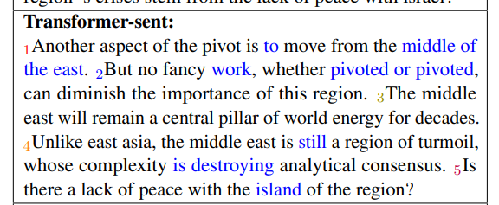
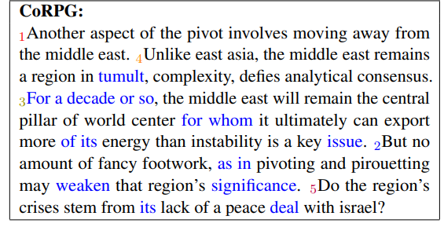
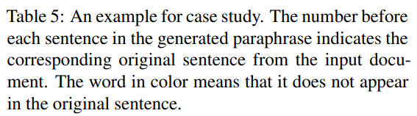
Experiments

Slide 18
Thank you！

